Slide 1

IBM watsonx Orchestrate Advanced Observability Sept 9-10th, 2025 Coppell, TX
Sara Hrnciar
Solutions Architect, TD SYNNEX
Sara.Hrnciar@tdsynnex.com

Slide 2

Agenda 1. Importance of Observability and Monitoring 3. Observability vs. Monitoring 4. Vocabulary 5. Observability and Monitoring in Orchestrate 6. Lab 7. Recap

Slide 3
An agent suddenly takes 3x longer to complete its tasks – What’s your first move?
Notes:
Before I talk your ears off, I want to give you all a couple minutes to speak amongst yourselves about this question

Slide 4
What IBM offers
Why IBM watsonx for enterprise AI?
Open
Based on the best of open technologies to integrate with your existing environments and run across the hybrid cloud
Trusted
Build responsible AI backed by enterprise governance, security, and transparency
Targeted
Pre-built and customizable AI designed for enterprise and targeted at business domains
IBM Data Platform / © 2025 IBM Corporation
Notes:
Three pillars
Cant be trusted if not observable

Slide 5

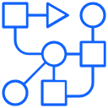










How Orchestrator agent reasons & executes across domains
Evaluation and reflection…
Autonomous reasoning and execution…
Input
Route
Plan
Execute
Outcome
Employee Transfer
I need to transfer Francesca Lopez to Katherine Howe before the holidays and before end of year.
Search
Transfer
Generate
Send
The transfer request for your employee has been completed…
AskHR
Agent
…..
Orchestrator Agent
Sales Prospecting
Next use case or domain
I need to send an email with our updated sales play to our discount eligible accounts.
AskSales
Agent
Consult
Retrieve
Validate
Generate
Send
Emails with discount offers based
on new sales plays have been sent…
…..
Notes:
Example to show how observability impacts trust
I have a coworker on my team and his focus area is watsonx governance. He has a great presentation, and one of the most stand out lines is when he sais, “We don’t want our AI applications to be a black box. We want them to be a transparent box”

Slide 6
Observability vs. Monitoring
Reactive
Proactive
Telemetry Data
Works Together
Dashboards
Traversable Maps
Monitoring
Assesses system health by collecting and analyzing aggregated data from IT systems, based on a predefined set of metrics and logs.
Observability
The ability to understand a complex system’s internal state based on external outputs
Tracks predefined metrics
Tracks interactions (inputs and outputs)
Source: Observability vs. Monitoring: What's the Difference? | IBM
Notes:
Observability vs monitoring

Slide 7
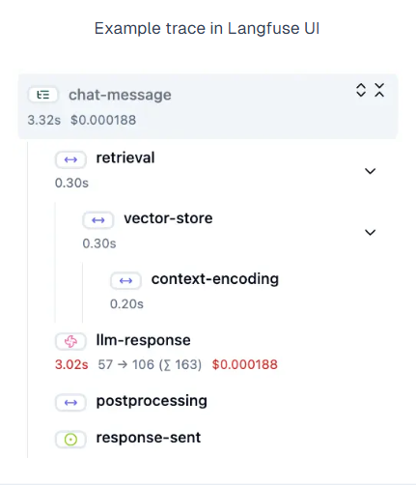
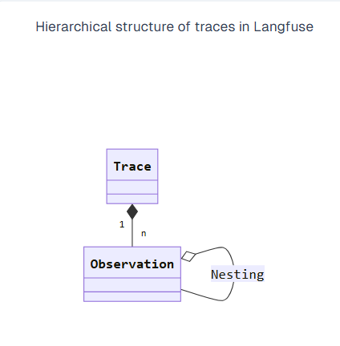
Traces and Observations
Place imagery here
Traces
Represents a single request or operation to an LLM
One trace contains many observations
Observations
Logs the individual steps of the execution.
Each trace can contain multiple observations
Types of Observations
Events are the basic building blocks. They are used to track discrete events in a trace.
Spans represent durations of units of work in a trace.
Generations are spans used to log generations of AI models incl. prompts, token usage, and costs.
Notes:
Traces and observations build Langfuse’s observability platform
Where a trace represents a single interaction, a single messaage, on the client side, that a user makes to an LLM or an agent
This trace will contain within it one or more observations. An observation will occur on the LLM side, and it logs the individual steps an agent took to reach its goal. the number of observations then depends on the agent’s perceived goal. Is it as simple as generating a response? Will the agent need to call tools? What are all of the steps this agent needs to take to complete its task?
What this means is that When you look at a trace, and then view all of the observations, you are looking at a detailed summary of all of the steps your agent took to understand and complete its perceived goal

Slide 8
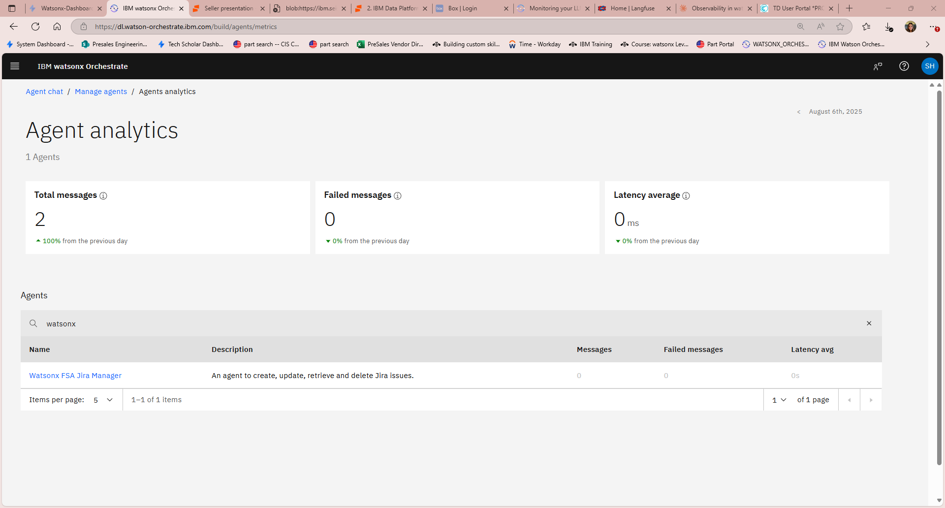
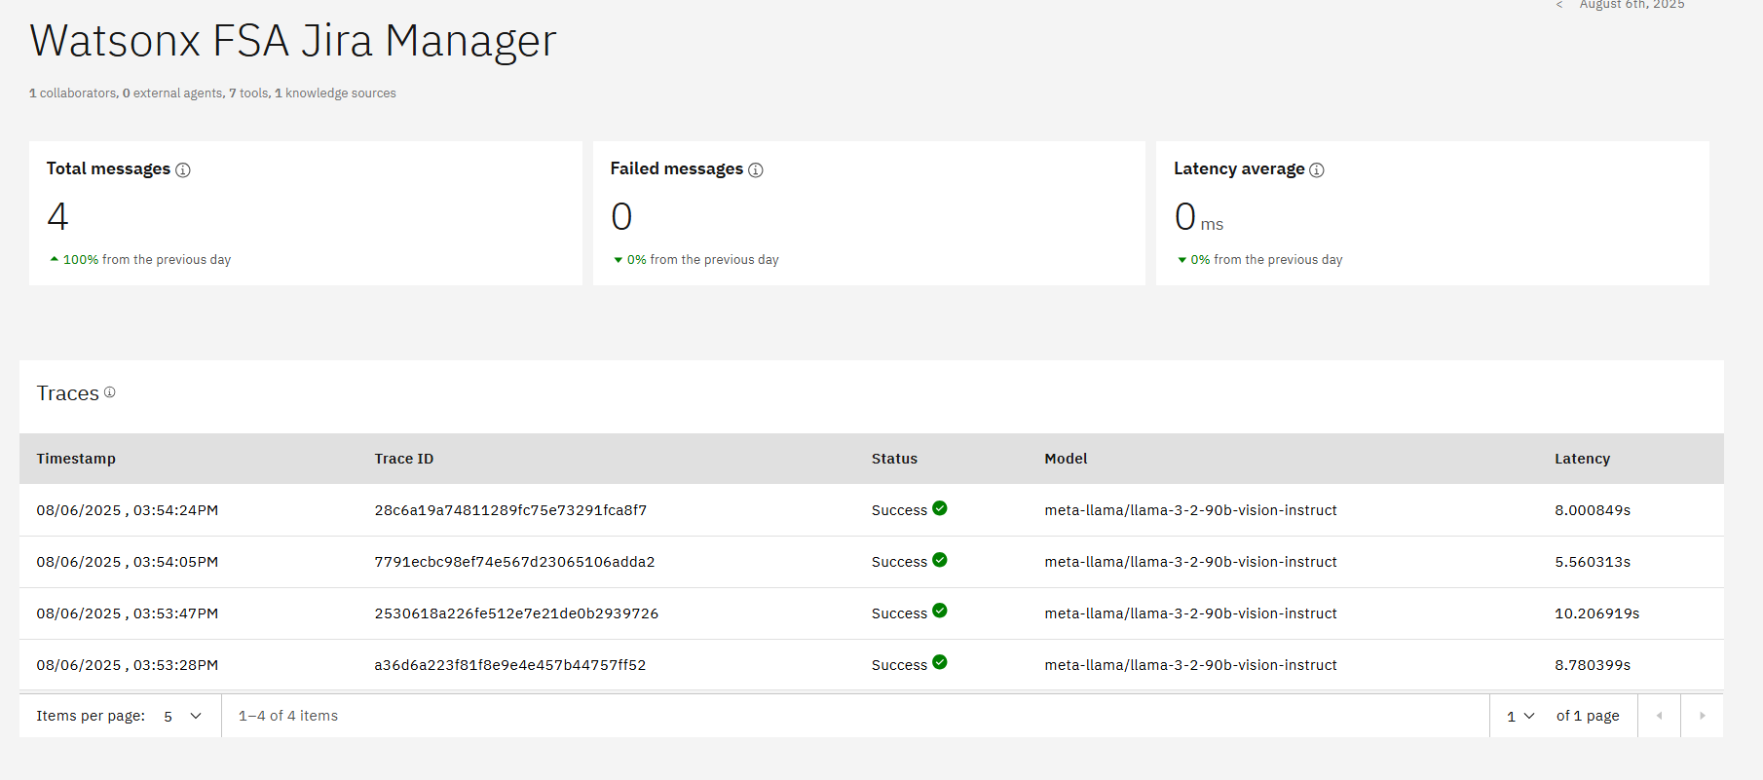
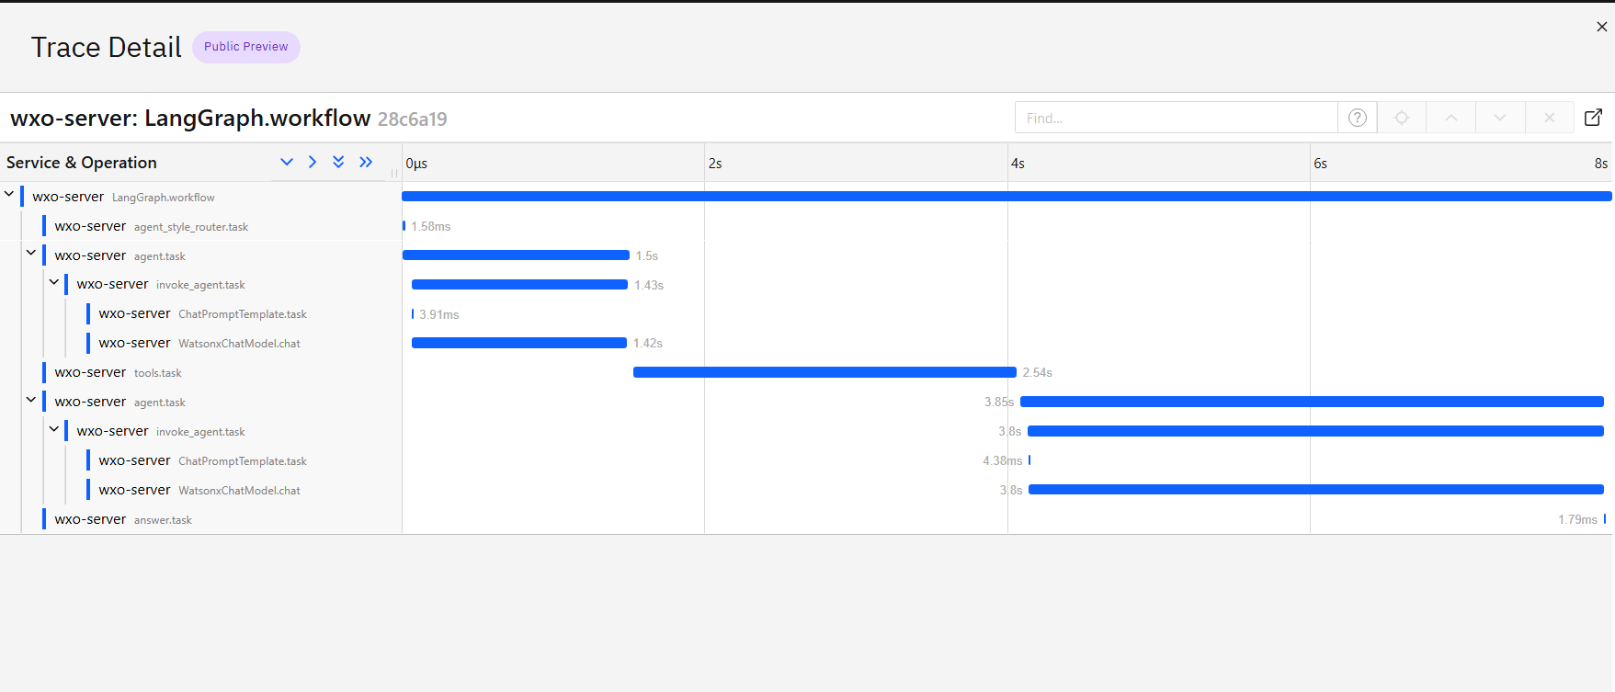
Agent monitoring with built-In Agent Analytics
Monitor & manage large numbers of AI agents at scale with centralized visibility into agent purpose, collaboration patterns, usage metrics & operational alerts
Notes:
Orchestrate already has built in monitoring dashboards for its agents, which includes a summary of messages sent, received, and average message latency in the past 24 hours. Additionally, you can view at a high level trace data for agent interactions in the past 24 hours.
This dashboard is nice as it’s a built in, unified interface for managing all deployed agents. It provides essential metadata on each agent, including descriptions, collaborators, and performance data, such as the number of monthly runs and chats, as well as real-time monitoring for errors, alerts, and warnings.
This is a great first step, But what do you do when this dashboard just isn’t enough?

Slide 9
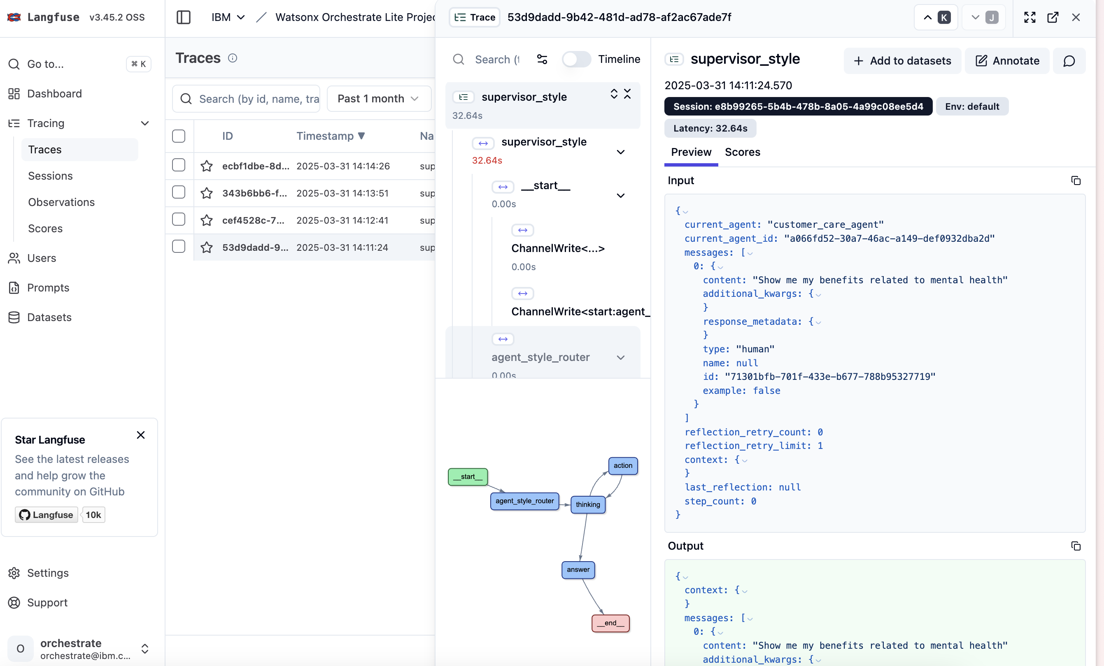
Observability with Langfuse
Fix errors, understand agent behavior, trace decision-making & ensure responsible outcomes
Documentation →
Notes:
As AI agents grow in complexity, debugging becomes critical, not just to fix errors, but to understand agent behavior, trace decision-making, and ensure responsible outcomes. That’s where Langfuse comes in.
Langfuse is an open-source observability platform purpose-built for AI applications to which watsonx Orchestrate provides native integration, giving developers powerful insight into how agents perform across every stage of the execution flow.
With Langfuse, developers can:
Trace prompts and tool executions
View end-to-end call chains across agents, tools, and large language model (LLM) interactions
Diagnose failure points, latency, and unexpected results
Monitor metrics like prompt duration, token usage, and retries
This level of transparency is essential for debugging and refining agent behavior, especially when orchestrating across multiple agents and tools.
And so finally, with langfuse enabled, we can move beyond black-box execution and gain full observability into agent reasoning and task execution. Langfuse really does enable that “trusted” component of “why ibm for enterprise ai” and it sets the foundation for reliable, trusted, and high-performing AI agents in production.

Slide 10

Lab: Observability
This lab guide will walk you through the process of connecting watsonx Orchestrate to Langfuse using the ADK
Notes:
And of course, with langfuse being so important, we will be setting it up in this lab

Slide 11

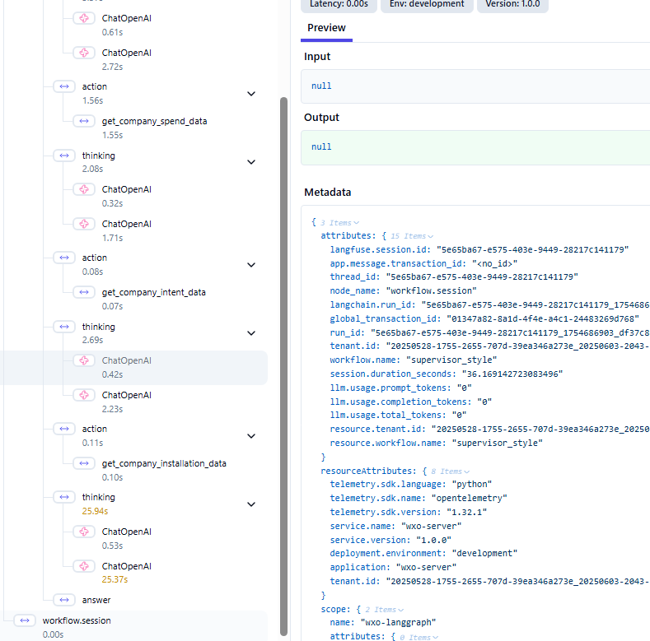
Post-Lab Exploration
Place imagery here
Search through the depth levels of one of your traces.
Find the level where all of the agents’ tools, knowledge, and abilities are wrapped into a single prompt to the base LLM.
Where did you find it? What did it look like?
Explore the structure of the prompt for react agent style vs default.

